Slide 1


CRM Data analysis
TEAM MEMBER
SURENDRA PRABHAKAR BHOSALE
MOHAMMED AWAIZ SHAIKH
ROHAN DATTARAM PALKAR
Baratam Ashish

Slide 2
INTRODUCTION
CRM (Customer Relationship Management) Data Analysis is the process of examining customer-related data to enhance business relationships, improve customer retention, and drive sales growth. It involves collecting, organizing, and analyzing customer interactions, transactions, and behaviors to gain insights that help businesses make data-driven decisions.
Benefits of CRM Data Analysis
Improved customer engagement & loyalty
Increased sales & revenue growth
Enhanced marketing effectiveness
Data-driven decision-making
Better customer experience & satisfaction

Slide 3
SUMMARY
The primary goal of this CRM Data Analysis project is to evaluate sales performance, lead conversion, and opportunity tracking across different industries. By analyzing CRM data, the project aims to provide insights into customer acquisition, sales forecasting, and marketing effectiveness, enabling data-driven decision-making.
Data Overview:
The project analyzes CRM data, including:
Opportunities (Active, Won, Lost)
Conversion Metrics (Conversion Rate, Win Rate, Loss Rate)
Lead Sources (Website, Social Media, Webinars, Referrals, Advertisements, etc.)
Industry Segmentation (Banking, Telecommunications, Biotechnology, Agriculture, etc.)
Sales Performance Over Time (Closed-Won vs. Total Closed Opportunities)
Forecasting & Revenue Estimation

Slide 4
KPI List
Opportunity KPI’s
Expected Amount
Active Opportunities
Conversion Rate
Win Rate
Loss Rate
Expected Vs Forecast
Active Vs Total Opportunities
Closed Won Vs Total Opportunities
Closed Won Vs Total Closed
Expected Amount by Opportunity Type
Opportunities by Industry
Lead KPI’s
Total Lead
Expected Amount from Converted Leads
Conversion Rate
Converted Accounts
Converted Opportunities
Lead By Source
Lead By industry
Lead by Status
Leads by Stage
Market segment by Converted opportunity

Slide 5
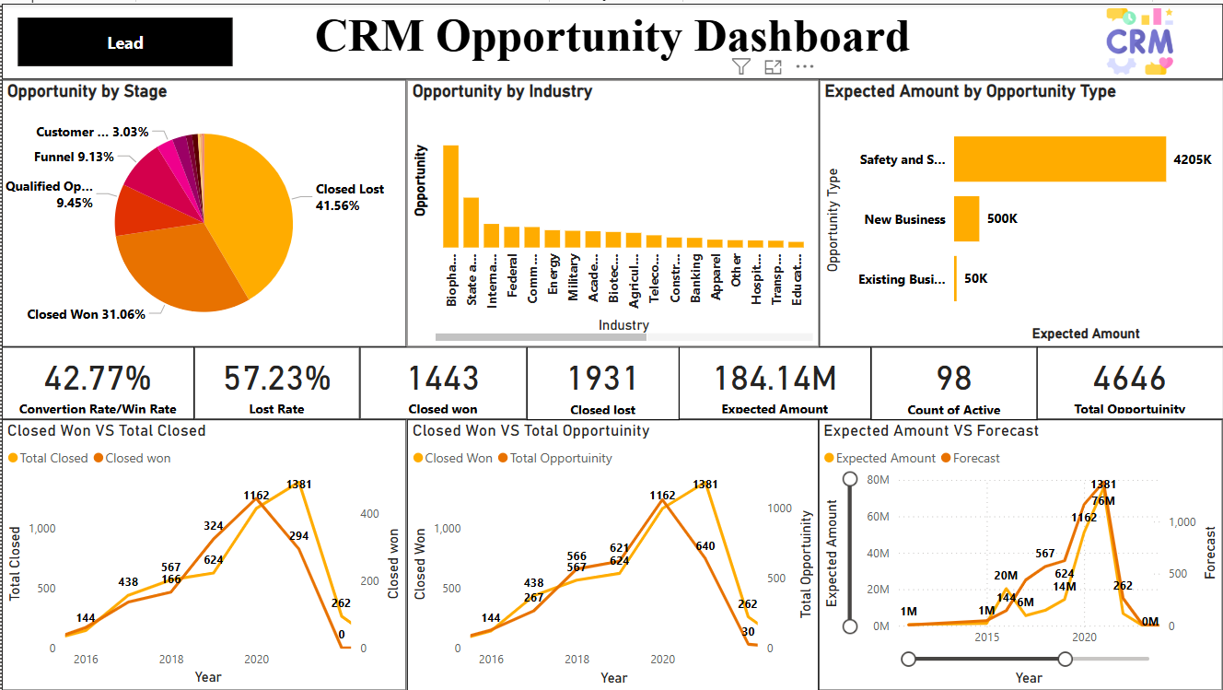
Power BI Dashboard

Slide 6
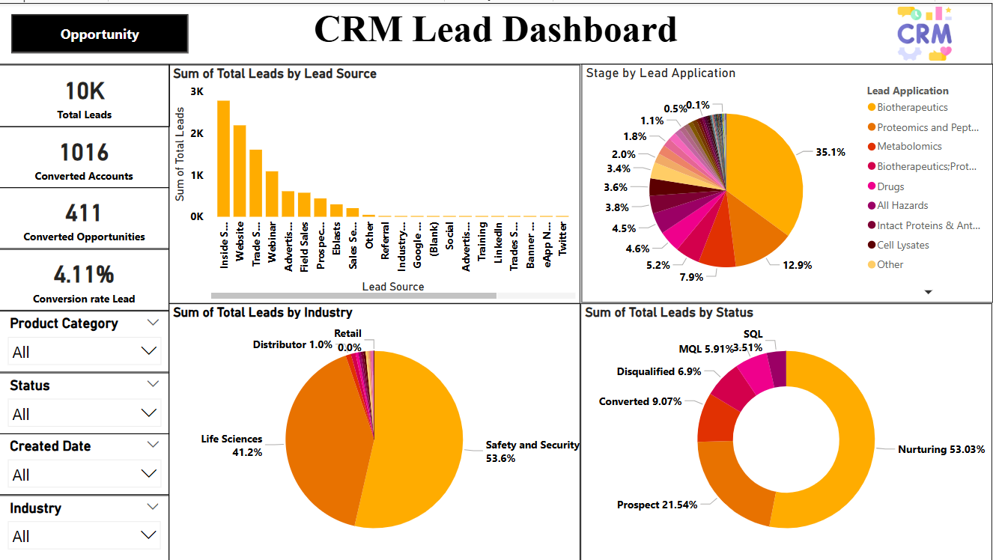

Slide 7
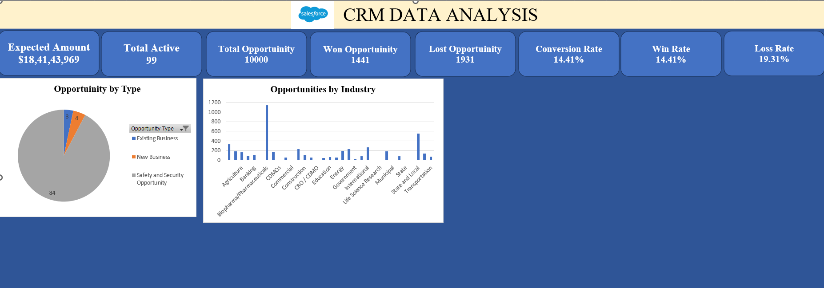
Excel dashboard

Slide 8
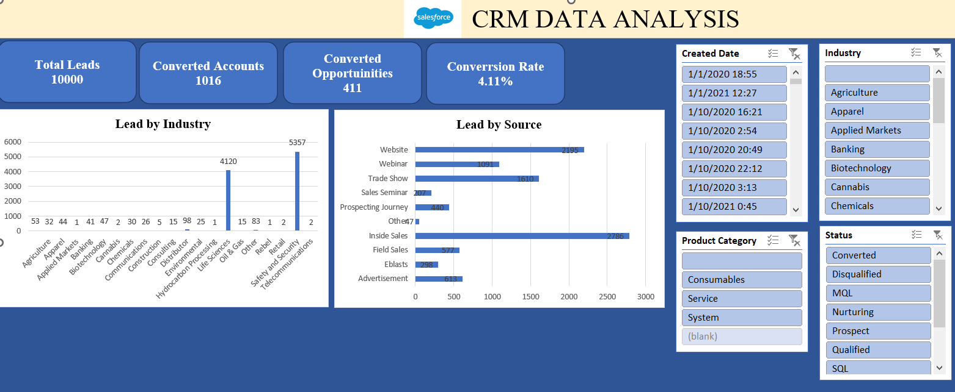

Slide 9
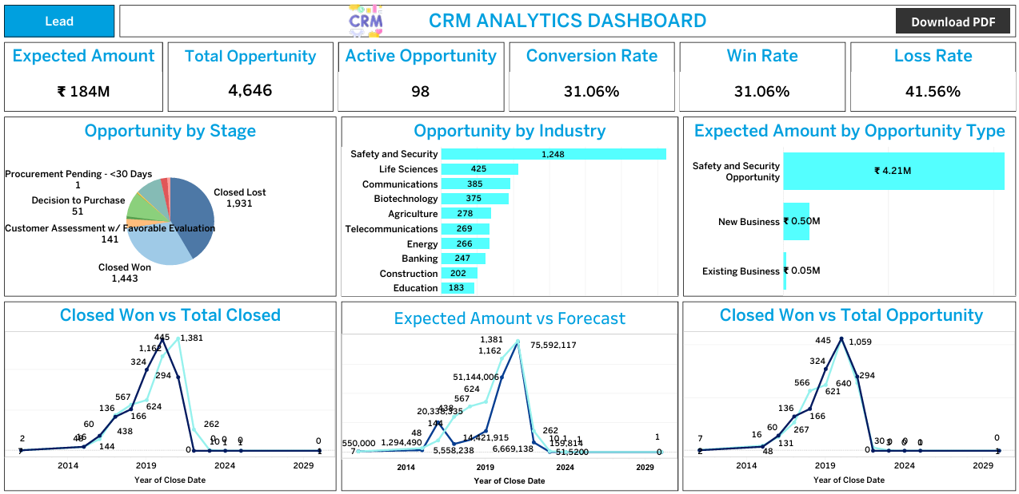
Tableau Dashboard

Slide 10
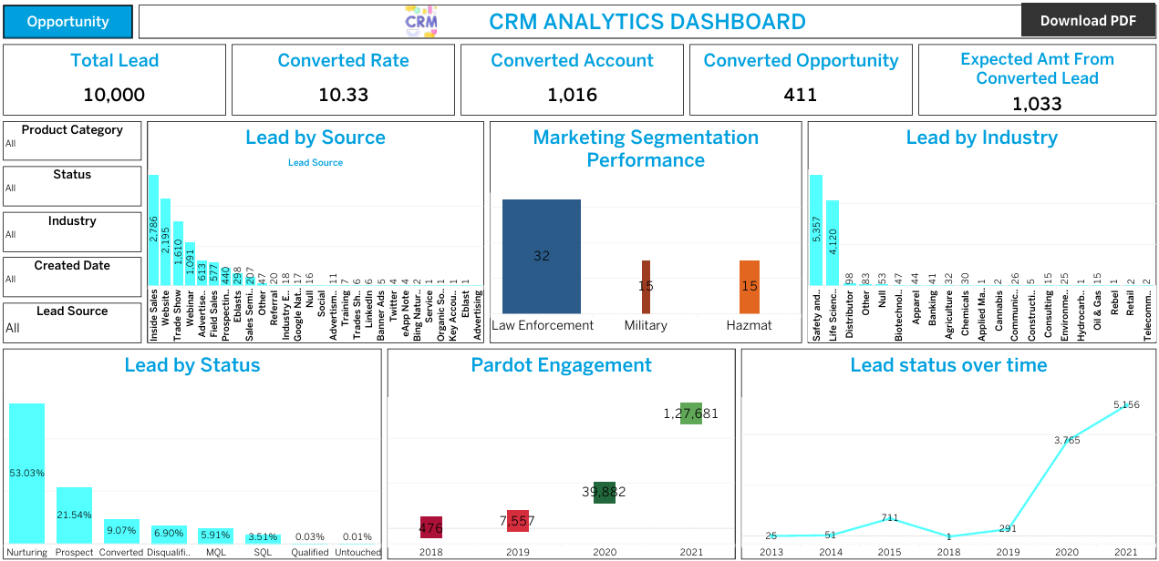

Slide 11




SQL QuerIES
# Expected Amount
SELECT CONCAT('$', FORMAT(SUM(Expected_Amount) / 1000000, 2), 'M') AS Total_Expected_Amount
FROM oppertunity_table;
# Active Opportunities
SELECT COUNT(Active) AS Active Opportunities FROM user_table;SELECT COUNT(Active) AS Active_Opportunities
FROM user table;
# Total Opportunities
SELECT COUNT(opportunity_ID) AS Total_Opportunities
FROM oppertunity_table;
# Conversion rate
SELECT CONCAT(ROUND((COUNT(CASE WHEN Stage = 'Closed Won' THEN 1 END) * 100.0) / COUNT(*), 2), '%') AS Conversion_Rate FROM oppertunity_table;

Slide 12


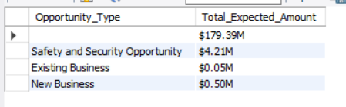
# Win rate
SELECT CONCAT(ROUND((COUNT(CASE WHEN Stage = 'Closed Won' THEN 1 END) * 100.0) / COUNT(*),2), '%') AS Win_Rate
FROM oppertunity_table;
# Loss rate
SELECT CONCAT(ROUND((COUNT(CASE WHEN Stage = 'Closed Lost' THEN 1 END) * 100.0) / COUNT(*),2), '%') AS Loss_Rate
FROM oppertunity_table;
# Expected Amount by Opportunity Type
SELECT Opportunity_Type, CONCAT('$', FORMAT(SUM(Expected_Amount) / 1000000, 2), 'M') AS Total_Expected_Amount
FROM oppertunity_table
GROUP BY Opportunity_Type;

Slide 13
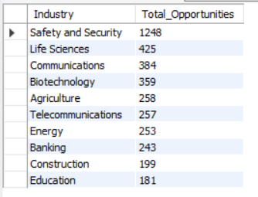
# Opportunities by Industry
SELECT A.Industry, COUNT(O.Opportunity_ID) AS Total_Opportunities FROM Oppertunity_table O
JOIN Account A ON O.Account_ID = A.Account_ID
GROUP BY A.Industry
ORDER BY Total_Opportunities DESC
LIMIT 10;

Slide 14




# Total leads
SELECT COUNT(Total_leads) AS Total_Leads FROM leads;
# Conversion Rate (%)
SELECT CONCAT(ROUND((COUNT(CASE WHEN Converted = 'True' THEN 1 END) * 100.0 / COUNT(*)), 2), '%' ) AS Conversion_Rate
FROM leads;
# Converted Accounts
SELECT COUNT(Converted_Account_ID) AS Converted_Accounts FROM leads
WHERE Converted = 'True';
# Expected Amount from Converted Leads
SELECT CONCAT('$', FORMAT(SUM(O.Expected_Amount) / 1000000, 2), 'M') AS Total_Expected_Amount_from_Converted_Leads
FROM leads L
JOIN oppertunity_table O ON L.Converted_Opportunity_ID = O.Opportunity_ID
WHERE L.Converted = 'True';

Slide 15

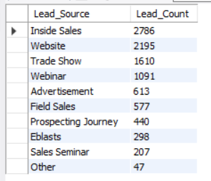
# Converted Opportunities
SELECT count(Converted_Opportunities) AS Count_of_Converted_Opportunities
FROM leads
WHERE Converted = 'True';
# Leads by Source
SELECT Lead_Source, COUNT(*) AS Lead_Count
FROM leads
GROUP BY Lead_Source
ORDER BY Lead_Count DESC
LIMIT 10;

Slide 16
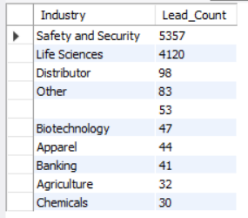
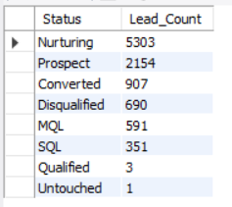
# Leads by Industry
SELECT Industry, COUNT(*) AS Lead_Count
FROM leads
GROUP BY Industry
ORDER BY Lead_Count DESC
LIMIT 10;
# Leads by Status
SELECT Status, COUNT(*) AS Lead_Count
FROM leads
GROUP BY Status
ORDER BY Lead_Count DESC;

Slide 17
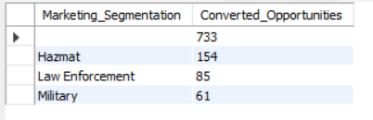
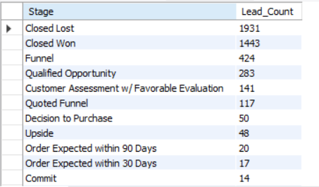
# Market segment by Converted opportunity
SELECT Marketing_Segmentation, COUNT("Converted_Opportunity_ID") AS Converted_Opportunities
FROM leads
WHERE Converted = 'True’
GROUP BY Marketing_Segmentation
ORDER BY Converted_Opportunities DESC;
# Leads by Stage
SELECT Stage, COUNT(*) AS Lead_Count
FROM oppertunity_table
GROUP BY Stage
ORDER BY Lead_Count DESC;

Slide 18
Key takeways
Opportunity Analysis:
Active and total opportunities were evaluated based on various industries.
The conversion rate, win rate, and loss rate provide insights into sales performance.
Lead Generation & Marketing Insights:
Leads were categorized based on their source (Website, Trade Show, Webinar, Advertisement, Social Media, Referrals, etc.).
The lead conversion rate was analyzed to determine the effectiveness of different marketing channels.
Leads were further segmented by industry and status (Nurturing, Prospect, Converted, Disqualified, MQL, SQL, Qualified, Untouched).

Slide 19
Key takeways
Sales Forecasting & Performance Tracking:
Closed Won vs. Total Closed opportunities were visualized over time.
Expected amounts were compared to forecasts to measure sales performance accuracy.
Engagement and last activity tracking were included for further analysis.

Slide 20
Conclusion
The CRM data analysis provides actionable insights into sales performance, lead conversion, and business opportunities.
Identifying the most effective lead sources helps optimize marketing strategies and allocate resources efficiently.
Tracking opportunities by industry and business type enables better sales forecasting and decision-making.
Addressing gaps in the sales funnel (e.g., high procurement pending days, low conversion rates) can improve revenue generation.
Continuous monitoring and refinement of CRM strategies are essential for sustained business growth.

Slide 21
THANK YOU

